Slide 1

Unit 5 Assignment - Technology Innovation – Part 1
HU
Herzing University
Amon-ra
BU 620-8 Technology and Innovation

Slide 2
Company
Sephora
Sephora is one global beauty and cosmetic company. Founded in 1970 in France by Dominique Mandonnaud and presently owned under the parent company LVMH Moët Hennessy Louis Vuitton, Sephora provides luxury goods in an assortment of categories to countries around the world.

Slide 3

Business and Organizational Context
A recent innovation in the Sephora company has solved an ongoing issue for customers in the cosmetic market.

Slide 4
Business and Organizational Context
The beauty product consumers have always been faced with being unable to locating the proper cosmetic foundation.

Slide 5
Business and Organizational Context
Customers are usually forced to settle for products that do not match their skin tone, giving the wearer a two-tone appearance.

Slide 6

Business and Organizational Context
To remedy this, Sephora has created a revolutionary technology coined Color IQ. Sephora’s Color IQ technology scans the face of the customer and identifies their Color IQ number.

Slide 7
Business and Organizational Context
The number corresponds to 1 within 1500 of their foundation products. The Sephora’s Color IQ technology scan is available only instore. Customers can visit any of their locations to access the face scanning service.

Slide 8
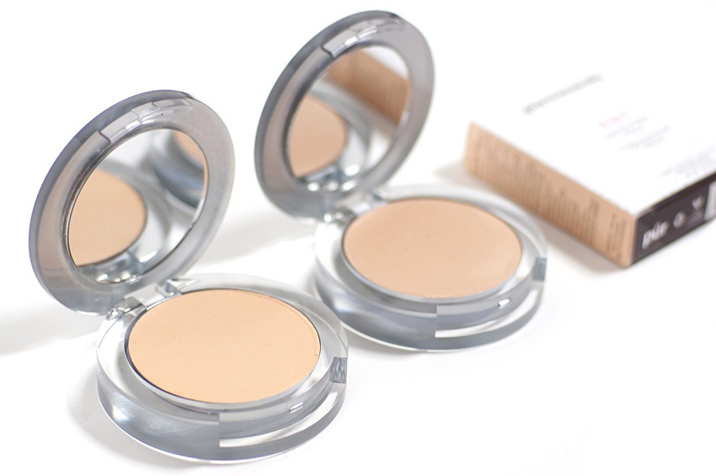
Proposed Innovation
The next innovative phase of this revolutionary technology, expands the accessibility of the service and creates a more convenient experience for the consumer.

Slide 9
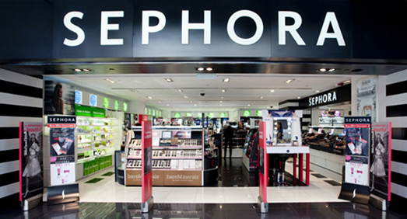
Proposed Innovation
Color IQ technology is confined to retail locations. Sephora will expand the presence of its Color IQ by placing this technology in millions of locations.

Slide 10

Proposed Innovation
Constructing millions of physical locations at a rapid pace would a superhuman task. Using digital infrastructure of internet, as opposed to physical location, can instantly expand around the globe.

Slide 11
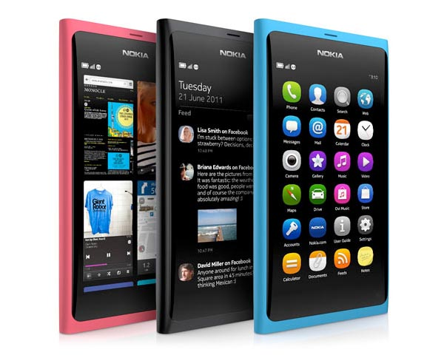
Proposed Innovation
Smart phones are more technologically advanced than most personal computers. They are mobile, present everywhere at all times, and very accessible.

Slide 12
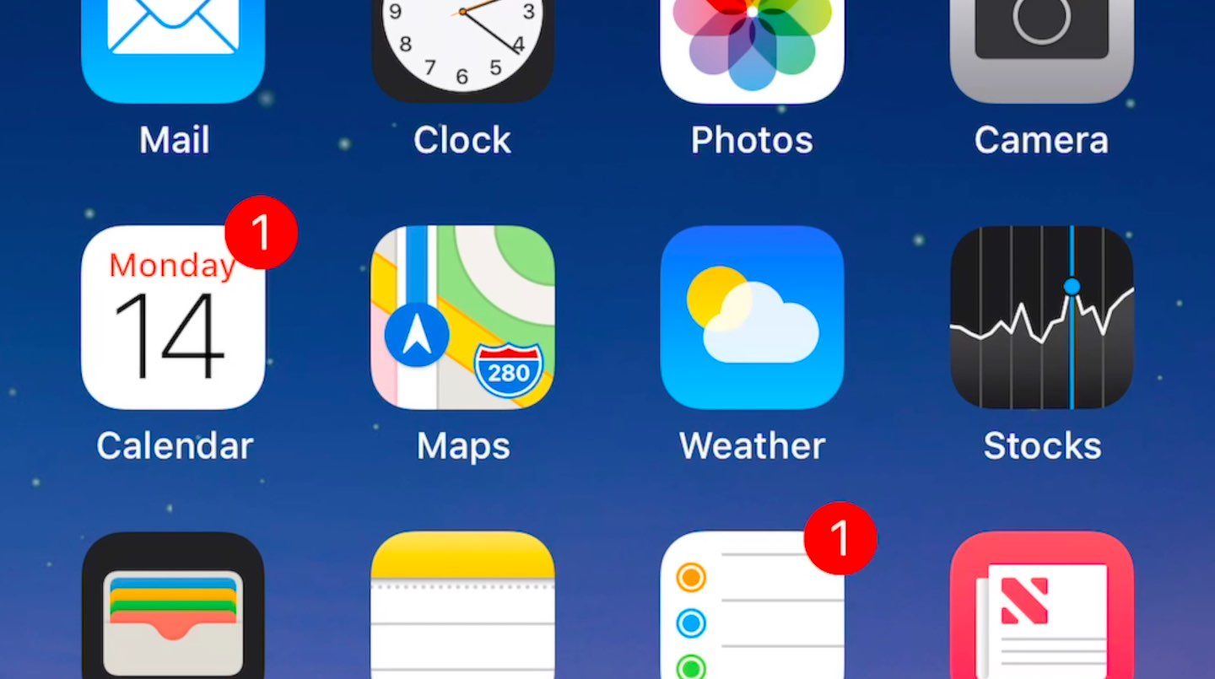
Proposed Innovation
With the creation of an app, Sephora can rapidly expand the presence of Color IQ technology to be anywhere at anytime. Customers can place their immediately upon obtaining their Color IQ number.

Slide 13

Strategic Competitive Advantage
Increased presence of Color IQ Technology
Convenience
Eliminate the need to travel to a physical
Decreased time from customer interest to sale through the elimination of travel
Customers can instantly share the experience of Color IQ with their friends

Slide 14
Origin of the Idea
Upon discovering that Sephora created Color IQ, which is available at their locations, it immediately became apparent that this technology would be expensive to expand at brick-and-mortar locations. A large amount of expense could be saved by using what presently in place much like companies such as Lyft and Uber that have cut inventory costs with drivers using their own vehicles.

Slide 15
Requirements
The most popular smart phone operating systems are Android and IOS for Apple. This innovative idea will require identifying a programming language or app-builder platform that can be used to create the mobile application. The company can contract a 3rd party company to develop and deploy the app or invest in-house mobile application and support team.

Slide 16
References
About Us. (n.d.). Retrieved December 1, 2019, from https://www.sephora.com/beauty/about-us.
Huezo, M. (2015, June 2). Five Brands That Are Setting The Bar For Customer Experience Innovation. Retrieved from https://www.limaconsulting.com/five-brands-that-are-setting-the-bar-for-customer-experience-innovation/.
Lyft, Inc. (n.d.). Vehicle requirements. Retrieved December 1, 2019, from https://help.lyft.com/hc/en-us/articles/115013077448-Vehicle-requirements.
Top 10 Mobile Phones Operating Systems. (2018, August 11). Retrieved from https://www.shoutmeloud.com/top-mobile-os-overview.html.

